Slide 1
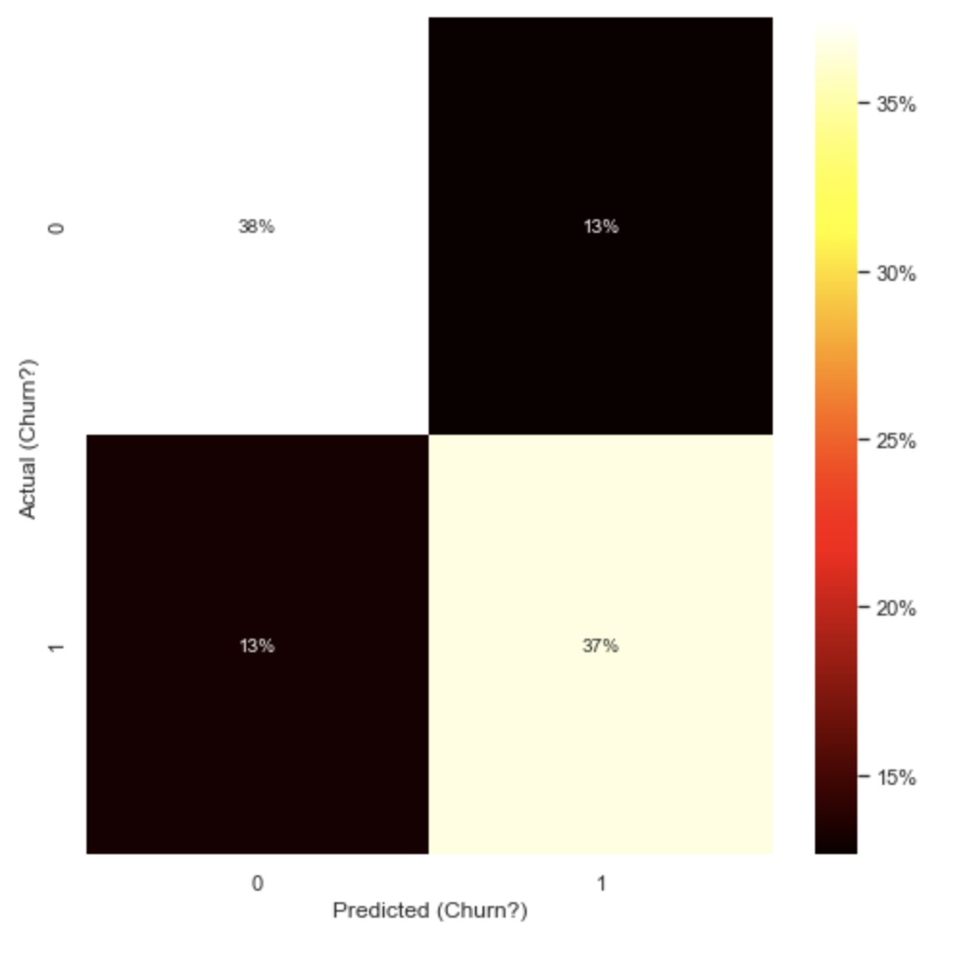

Using SMOTE our model achieves a 73% accuracy in predicting the likelihood for a customer churning based on the data set at hand
Are we able to predict churn risk?*
Chosen Hypothesis
H₀ – We can predict if a customer will churn
H_{A} – We cannot predict if a customer will churn
Approach & Outcome
Approach:
Logistic regression with SMOTE applied to the data set
Outcome:
Our model’s accuracy is at roughly 73%, offering a strong basis
However, roughly 26% of clients predicted to stay – in fact – churned, giving us a high rate of false negatives
To improve our model’s accuracy we could:
Revisit if we have all relevant independent variables in the data set
If churn probability would be better represented by a continues variable ranging from 0 to 1
*) Churn risk is captured in a bool (yes/no)

